Slide 1
ELE 568 – Degree Dynamics
Prepared by Ali GÜVEN
211217001

Slide 2
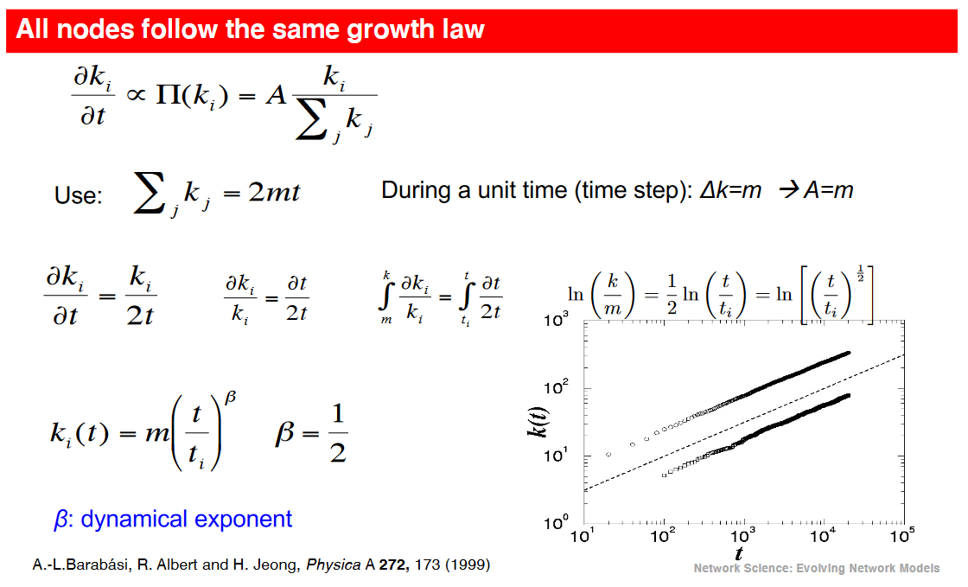
Question – Proof of Time Evolution of the Barabási-Albert Model

Slide 3
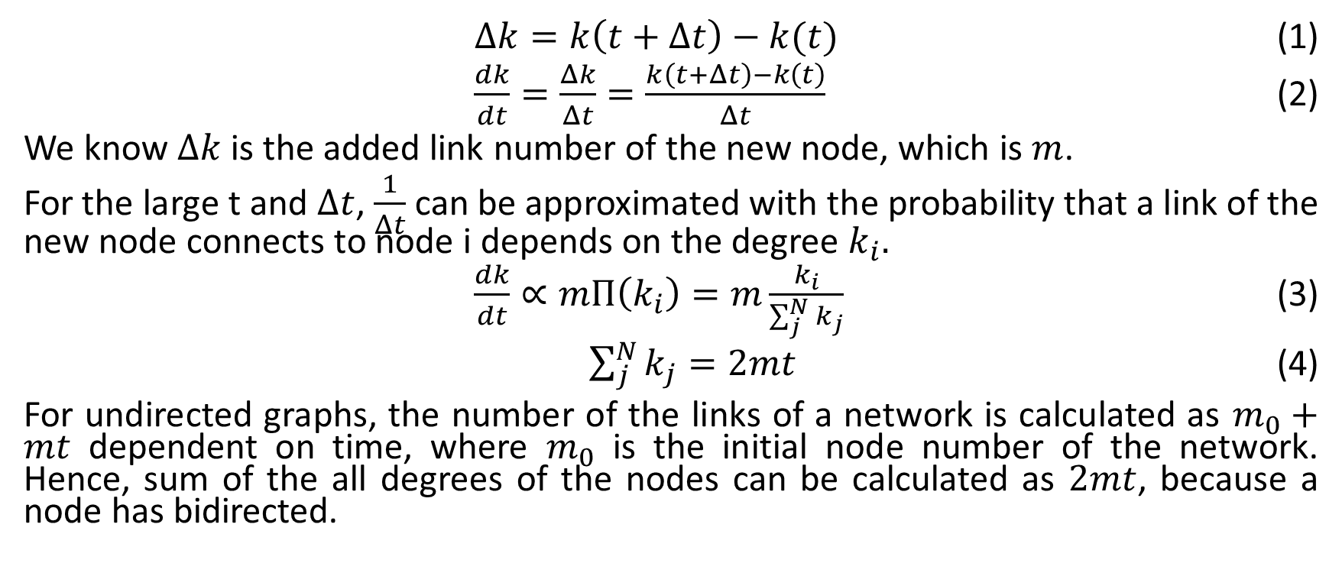
Solution
$Δk=k\left(t+Δt\right)−k(t)$ (1)
$\frac{dk}{dt}=\frac{Δk}{Δt}=\frac{k\left(t+Δt\right)−k\left(t\right)}{Δt}$ (2)
We know $Δk$ is the added link number of the new node, which is $m$.
For the large t and $Δt$, $\frac{1}{Δt}$ can be approximated with the probability that a link of the new node connects to node i depends on the degree $k_{i}.$
$\frac{dk}{dt}∝mΠ\left(k_{i}\right)=m\frac{k_{i}}{\sum_{j}^{N}{k_{j}}}$ (3)
$\sum_{j}^{N}{k_{j}}=2mt$ (4)
For undirected graphs, the number of the links of a network is calculated as $m_{0}+mt$ dependent on time, where $m_{0}$ is the initial node number of the network. Hence, sum of the all degrees of the nodes can be calculated as $2mt$, because a node has bidirected.

Slide 4
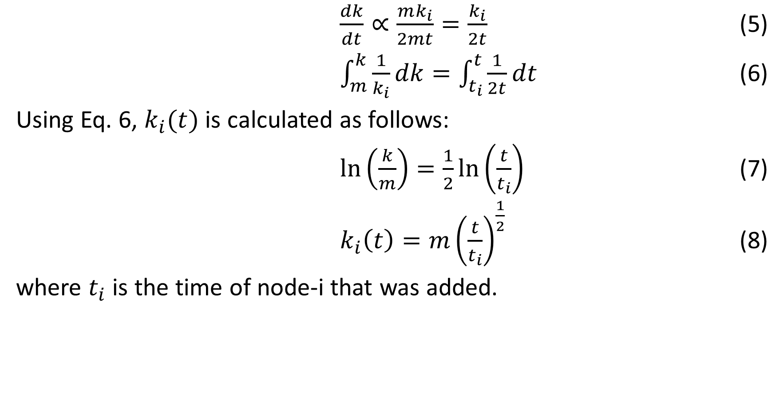
$\frac{dk}{dt}∝\frac{mk_{i}}{2mt}=\frac{k_{i}}{2t}$ (5)
$\int_{m}^{k}{\frac{1}{k_{i}}dk=\int_{t_{i}}^{t}{\frac{1}{2t}dt}}$ (6)
Using Eq. 6, $k_{i}(t)$ is calculated as follows:
$\ln\left(\frac{k}{m}\right)=\frac{1}{2}\ln\left(\frac{t}{t_{i}}\right)$ (7)
$k_{i}\left(t\right)=m{\left(\frac{t}{t_{i}}\right)}^{\frac{1}{2}}$ (8)
where $t_{i}$ is the time of node-i that was added.

Slide 5
Simulation
Initial Number of Nodes: 100 Last Number of Nodes: 1100
Initial Number of Links: 2500 Last Number of Links: 52500

Slide 6
Libraries
matplotlib
networkx
numpy
os
natsort
imageio

